Slide 1
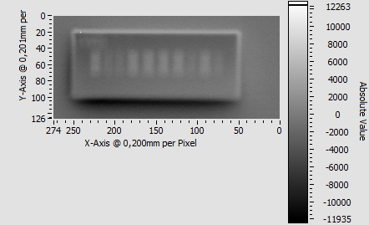
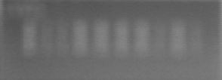
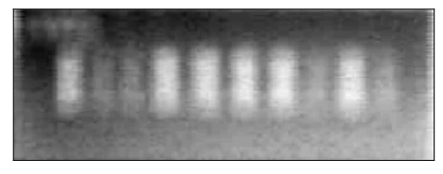

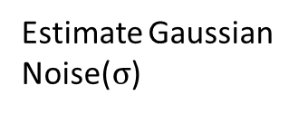
Filtering Image
Cropped and Converted To Gray Scale
Apply Gaussian Filter with Sigma value as = $σ$
Estimate Gaussian Noise($σ$)

Slide 2
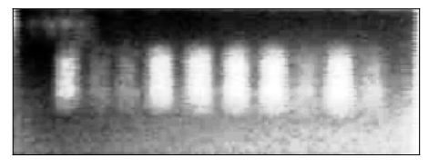
Equalizing Histogram of the Exposure gathered by the Gaussian Filtered Image.
Enhanced contrast of the Image. (Makes it easy to differentiate between Bands on the overall Image)

Slide 3

Detecting Image
Extracting the Middle Column ( mid_col )
Averaging Intensities Row Wise
Transpose of Final Filtered Image
[mid_col – 20 : mid_col + 20]

Slide 4
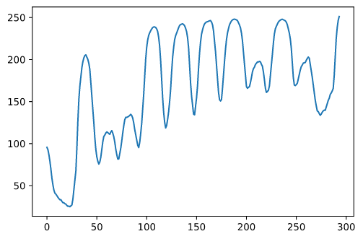
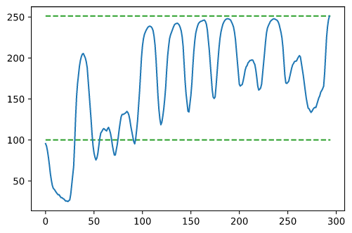
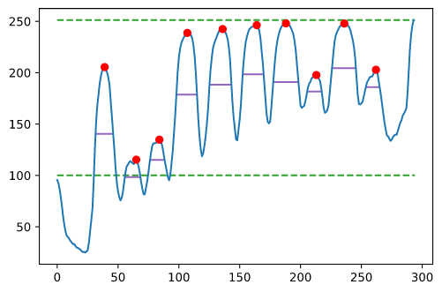
Plotting the Average of the intensities.
Setting Upper and Lower thresholds to consider Peaks.
Finding Peaks and it’s width.

Slide 5
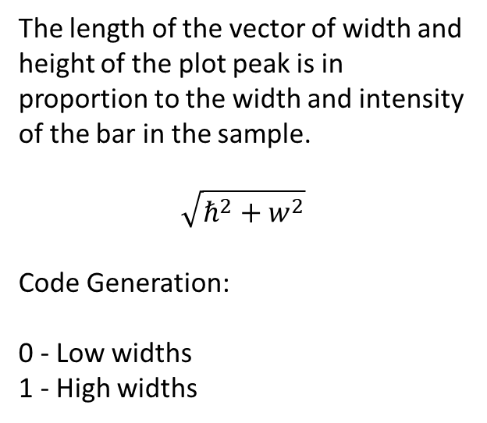
Plot and It’s Significance
Intensity Levels
h
w
The width of the band.
The height of the peak.
The length of the vector of width and height of the plot peak is in proportion to the width and intensity of the bar in the sample.
$$\sqrt{ℏ^{2}+w^{2}}$$
Code Generation:
0 - Low widths
1 - High widths
[1 0 0 1 1 1 1 0 1 0]
Code

Slide 6
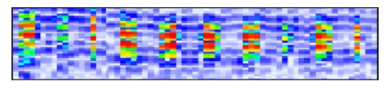
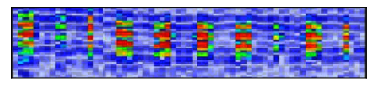
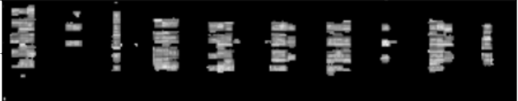
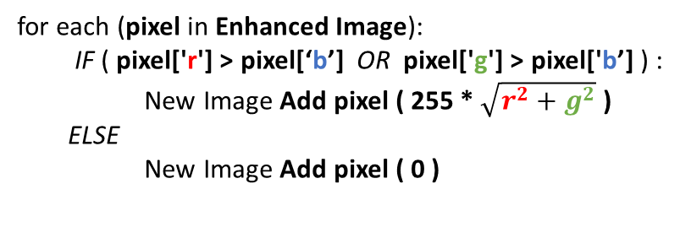
Ultrasonic Image
Equalize Histogram Enhancement
Original Image
Enhanced Image
Apply Algorithm and generate New Image
for each (pixel in Enhanced Image):
IF ( pixel['r'] > pixel[‘b’] OR pixel['g'] > pixel['b’] ) :
New Image Add pixel ( 255 * $\sqrt{r^{2}+g^{2}}$ )
ELSE
New Image Add pixel ( 0 )
Enhanced Image
New Grayscale Image

Slide 7

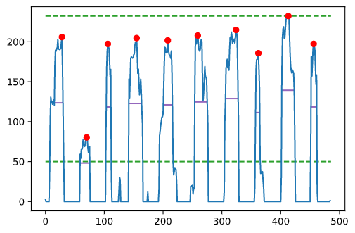



Extracting the Middle strip
[ middle_column - 10: middle_column + 10 ]
Averaging Intensities Row Wise and Plotting
New Grayscale Image Transposed
$$\sqrt{{(0.8W \text{)}}^{2}+(0.2{H)}^{2}}$$
$$W$$
$$H$$
[1 0 0 1 1 1 1 0 1 0]
Generated Code
The length of the vector of weighted width (weight = 0.8) and height (weight = 0.2) of the plot peak is in proportion to the thickness of the bar in the sample.

Slide 8
Data Matrix Code Extraction

Slide 9
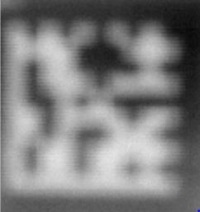
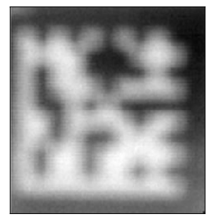

Steps Involved For Filtering
Gaussian Filter with Low Variance ($σ_{x}$ = 0.1 , $σ_{y}=0.1)$
Original Sample
(2mm x 2mm)
Low Gaussian
Gaussian Filter with High Variance ($σ_{x}$ =30 , $σ_{y}=30)$
Original Sample
(2mm x 2mm)
High Gaussian

Slide 10
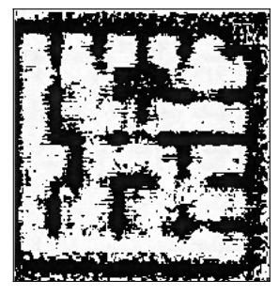
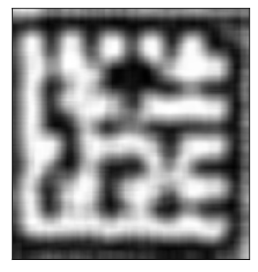
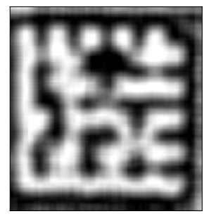
____
=
High Gaussian
Low Gaussian
Resulting Difference
Image
Gaussian Filter
Rescaling Intensity
With Variance ($σ_{x}$ = 15 , $σ_{y}=15)$
With 2 – 98 percentile Range
Resulting Difference
Image
Filtered Enhanced Image

Slide 11

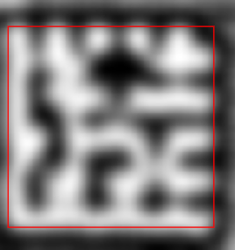
Using python Library Pylibdmtx for Decoding Data Matrix
Median Blur Filter
Passed through
Pylibdmtx decode
Filtered Enhanced Image
Final Output
Pylibdmtx also gives the rectangle coordinates of the field of interest.
Found Code:
658942
The data matrix reader Library is an open source library.

Slide 12
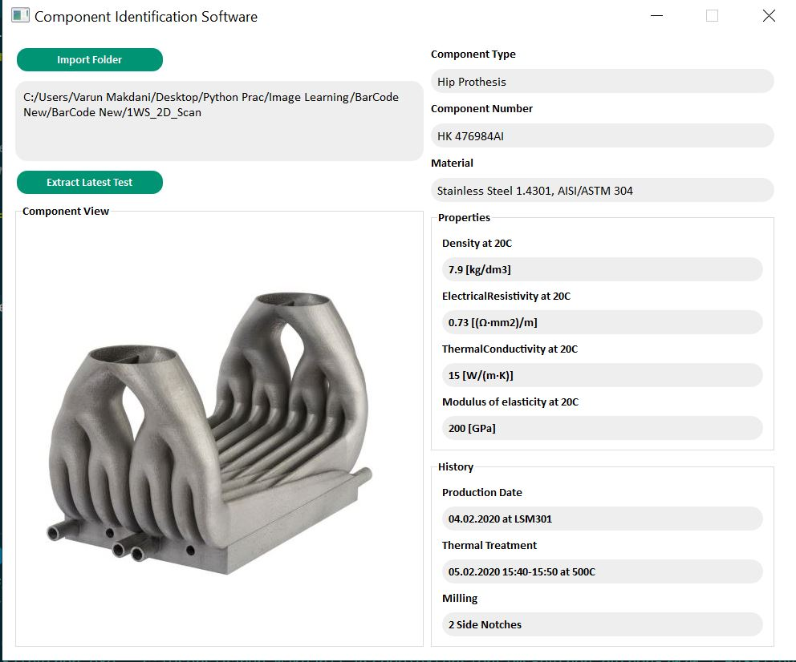
GUI

